Slide 1
Advanced JAVA
Database Connectivity

Slide 2
Introduction
Business applications usually store data in the databases.
In most of the enterprise applications, Relational Database Management Systems (RDBMS) are used as data storage. They store the data records in tables. Each record (such as that of an employee) is represented by a table row, which consists of one or more columns or record fields (e.g., name, address, hire date). RDBMS understand the SQL language.
The most popular RDBMS are Oracle, DB2, Sybase, Microsoft SQL Server, and MySQL Server.
JDBC API is not DBMS-specific — if you write a program that uses JDBC classes to retrieve/update data in Oracle, you’ll be using the same classes to work with MySQL Server or DB2. You just need the JDBC drivers from the corresponding DBMS vendor — the drivers hide their database specification behind the same public JDBC API.

Slide 3
API (Application Programming Interface)
API (Application programming interface) is a document that contains description of all the features of a product or software. It represents classes and interfaces that software programs can follow to communicate with each other. An API can be created for applications, libraries, operating systems, etc.
Java JDBC is a java API to connect and execute query with the database. JDBC API uses jdbc drivers to connect with the database. This API consists of a set of classes and interfaces to enable programmers to write pure Java Database applications.
Before JDBC, ODBC API was the database API to connect and execute query with the database. But, ODBC API uses ODBC driver which is written in C language (i.e. platform dependent and unsecured). That is why Java has defined its own API (JDBC API) that uses JDBC drivers (written in Java language)

Slide 4
JDBC VS ODBC
The most widely used interface to access relational database today is Microsoft’s ODBC API. ODBC performs similar tasks as that of JDC (Java Development Connection) and yet JDBC is preferred due to the following reasons :
ODBC cannot be directly used with Java because it uses a C interface. Calls from Java to native C code have a number of drawbacks in the security, implementation, robustness and automatic portability of applications.
ODBC makes use of pointers which have been totally removed from Java.
JDBC API is a natural Java Interface and is built on ODBC. JDBC retains some of the basic features of ODBC like X/Open SQL Call Level Interface.
JDBC is to Java programs and ODBC is to programs written in languages other than Java.
ODBC mixes simple and advanced features together and has complex options for simple queries. But JDBC is designed to keep things simple while allowing advanced capabilities when required.

Slide 5
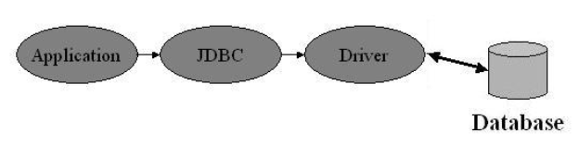
JDBC ARCHITECTURE
Java application calls the JDBC library. JDBC loads a driver which talks to the database.
JDBC contains three components: Application, Driver Manager, Driver.
The user application invokes JDBC methods to send SQL statements to the database and retrieves results. JDBC driver manager is used to connect Java applications to the correct JDBC driver . JDBC driver test suite is used to ensure that the installed JDBC driver is JDBC Compliant.

Slide 6
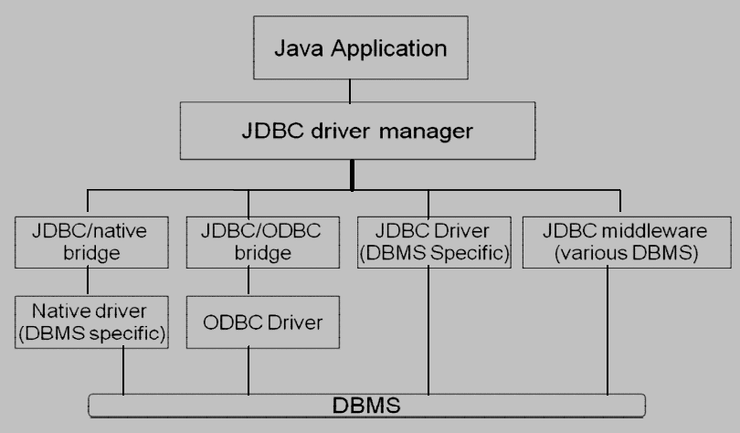
JDBC ARCHITECTURE

Slide 7
JDBC ARCHITECTURE/JDBC Driver Types
Type 1
JDBC-ODBC Bridge
Type 2
Native API, partially java driver
Type 3
JDBC Network Driver, partially java
Type 4
Native-protocol pure Java driver (100% Java )

Slide 8
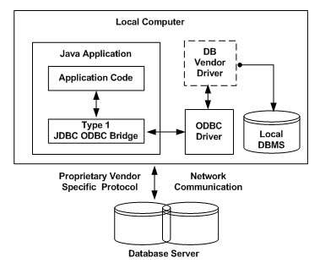
JDBC ARCHITECTURE/JDBC Driver Types
Type 1 Driver: JDBC-ODBC Bridge Driver
Translate JDBC into ODBC and use Windows ODBC built in drivers
ODBC must be set up on every client
driver must be physically on each machine for both java applications and applets
for server side applications, ODBC must be set up on web server
driver oracle.jdbc.odbc.JdbcOdbc provided by JavaSoft with JDK
Eg: JDBC-ODBC Bridge that comes with JDK 1.2

Slide 9
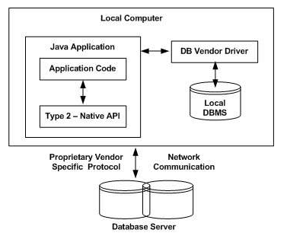
JDBC ARCHITECTURE/JDBC Driver Types
Type 2 Driver: JDBC-Native API
Native-API partly-Java driver converts JDBC calls into calls on the client API for Oracle, Sybase, Informix or other DBMS
like Type 1 drivers; requires installation of binaries on each client & not suitable for large networks.
Eg: Oracle Call Interface (OCI) driver.

Slide 10
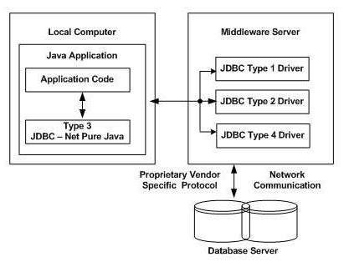
JDBC ARCHITECTURE/JDBC Driver Types
Type 3 Driver: JDBC-Net pure Java
three-tier approach is used to access databases. The JDBC clients use standard network sockets to communicate with a middleware application server.
The middleware connects its pure Java clients to many different databases. The type of protocol in this middleware depends on the vendor.
Most flexible driver type

Slide 11
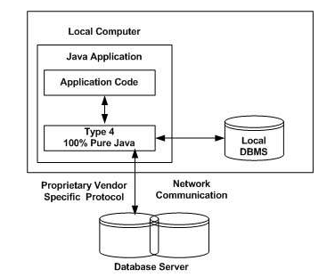
JDBC ARCHITECTURE/JDBC Driver Types
Type 4: 100% Pure Java
Converts JDBC directly to native API used by the RDBMS
Requests from client machines are made directly to the DBMS server.
Compiles into the application, applet & does not require anything to be installed on client machine, except JVM
They are also written in 100% Java and are the most efficient among all driver types.
Eg: MySQL's Connector/J driver is a Type 4 driver.

Slide 12
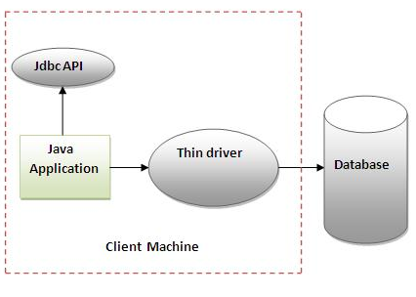
JDBC ARCHITECTURE/JDBC Driver Types
A Type 4 driver is a pure Java driver, which usually comes as a .jar file and performs direct calls to the database server. It does not need any configuration on the client’s machine, other than including the name of the main driver’s class in your Java code. That’s why it’s also known as the thin driver.
For example, Java applets can be packaged with this type of driver, which can be automatically downloaded to the user’s machine along with the applets themselves.

Slide 13
Which Driver should be Used?
If you are accessing one type of database, such as Oracle, Sybase, or IBM, the preferred driver type is 4.
If your Java application is accessing multiple types of databases at the same time, type 3 is the preferred driver.
Type 2 drivers are useful in situations, where a type 3 or type 4 driver is not available yet for your database.
The type 1 driver is not considered a deployment-level driver, and is typically used for development and testing purposes only.

Slide 14
Working with Databases using JDBC
A connection can be open with the help of following steps:
1. Importing Packages
2. Loading JDBC Drivers
3. Opening a Connection to a Database
4. Creating a Statement Object
5. Executing a Query and Returning a Result Set Object
6. Processing the Result Set
7. Closing the Result Set and Statement Objects
8. Closing the Connection

Slide 15
Working with Databases using JDBC
Importing Packages
import java.sql.* ; // for standard JDBC programs
import java.math.* ; // for Decimal and Integer support
JDBC API is in the package java.sql
It consists of interfaces, classes and exceptions .
Interfaces:
CallableStatement, Connection, DatabaseMetaData, Statement, Driver,
PreparedStatement, ResultSet, ResultSetMetaData etc.
Classes:
Date, DriverManager, DriverPropertyInfo, Time, Timestamp, Types
Exceptions:
DataTruncation, SQLException, SQLWarning

Slide 16
Working with Databases using JDBC
Loading JDBC Drivers
Load the JDBC driver using the method forName() of the Java class Class.
If you work with Oracle DBMS, load a Type 4 JDBC driver with the following command: Class.forName(“oracle.jdbc.driver.OracleDriver”);
The return type of the Class.forName (String ClassName) method is “Class”. Class is a class in java.lang package.
JDBC DRIVER
Data base | Driver class
Access | sun.jdbc.odbc.JdbcOdbcDriver
MySql | com.mysql.jdbc.Driver
Oracle | oracle.jdbc.driver.OracleDriver

Slide 17
Working with Databases using JDBC
Opening a Connection to a Database
The JDBC DriverManager class defines objects which can connect Java applications to a JDBC driver. DriverManager class manages the JDBC drivers that are installed on the system.
Its getConnection() method is used to establish a connection to a database. It uses a username, password, and a jdbc url to establish a connection to the database and returns a connection object.
Obtain the database connection to the database by calling
DriverManager.getConnection(url, user, password);
Driver: thin, If the database is on the same computer, then for the Host Name parameter, enter localhost, JDBC Port: 1521, SID: xe
Connection con= DriverManager.getConnection("jdbc:oracle:thin:@localhost:1521:xe","system","oracle");

Slide 18
Working with Databases using JDBC
Following table lists down the popular JDBC driver names and database URL.
RDBMS | JDBC driver name | URL format
ORACLE | oracle.jdbc.driver.OracleDriver | jdbc:oracle:thin:@hostname:portno:databaseName
MySQL | com.mysql.jdbc.Driver | jdbc:mysql://hostname/ databaseName
DB2 | COM.ibm.db2.jdbc.net.DB2Driver | jdbc:db2:hostname:port Number/databaseName
Sybase | com.sybase.jdbc.SybDriver | jdbc:sybase:Tds:hostname: portno/databaseName
All the highlighted part in URL format is static and you need to change only the remaining part as per your database setup.

Slide 19
Working with Databases using JDBC
JDBC URLs Examples
Database | Examples
Access | Connection con = DriverManager.getConnenction("jdbc:odbc:ExampleMDBDataSource");
MySql | Connection con = DriverManager.getConnenction("jdbc:mysql://localhost/javabook","scott","tiger");
Oracle | Connection con= DriverManager.getConnection("jdbc:oracle:thin:@localhost:1521:xe","system","oracle");

Slide 20
Working with Databases using JDBC
Creating a Statement Object
Once a connection is established, It is used to pass SQL statements to its underlying database.
JDBC provides three classes for sending SQL Statements to the database, where PreparedStatement extends from Statement and CallableStatement extends from PreparedStatement
Statement :
For simple SQL statements ( no parameter )
PreparedStatement :
For SQL statements with one or more IN parameters, or simple SQL statements that are executed frequently.
CallableStatement :
For executing SQL stored procedures.

Slide 21
Working with Databases using JDBC
Creating a Statement Object
Create an instance of the Java class Statement:
Connection.createStatement();
When an SQL statement is to be issued against the database, a Statement object must be created through the Connection. To execute SQL statements, you need to instantiate a Statement object from your connection object by using the createStatement() method. A statement object is used to send and execute SQL statements to a database.
Statement stmt= con.createStatement();
where con in connection object.

Slide 22
Working with Databases using JDBC
Executing a Query and Returning a Result Set Object
A Statement is an interface that represents a SQL statement. You execute Statement objects, and they generate ResultSet objects, which is a table of data representing a database result set.
ResultSet rs=stmt.executeQuery("select * from emp");
The statement interface provides three different methods for executing SQL statements :
SELECT | executeQuery(String sql)
INSERT, UPDATE, DELETE, CREATE, DROP | executeUpdate(String sql)
Stored procedure | execute(String sql)

Slide 23
Working with Databases using JDBC
Processing the Result Set
Write a loop to process the database result set, if any:
while (rs.next())
{
//Lines of Code…………...
}
where rs is ResultSet object.
rs.next() returns true if the new current row is valid, false if there are no more rows.
The other methods which can be used with Resultset object are :
first(),last(),previous()

Slide 24
Working with Databases using JDBC
Closing the Result Set ,Statement Objects & Closing the Connection
Free system resources by closing the ResultSet, Statement and Connection objects.
Resultset
Statement/Prepared Statement
Connections
Closing the connections using close( ) method.
At the end of your JDBC program, it is required explicitly to close all the connections to the database to end each database session.
However, if you forget, Java's garbage collector will close the connection when it cleans up stale objects.

Slide 25
JDBC Examples
Retrieve the data from oracle by using JDBC.
Install Oracle and make sure it is running (ie. connect to Oracle by sqlplus).
Create a table name student:
Insert data into student table.
commit the operation.
Column name | Data Type
rollno | varchar2(10)
name | char(25)
date_adm | date
per | number(4,2)

Slide 26
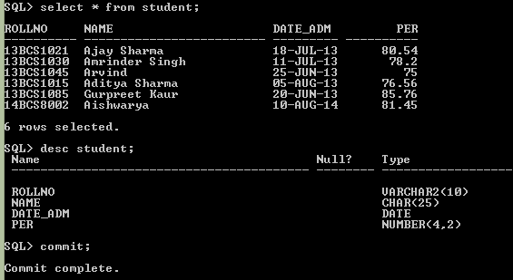
JDBC Examples

Slide 27
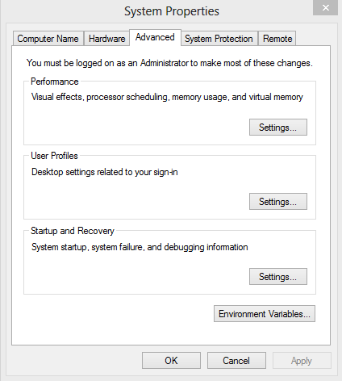
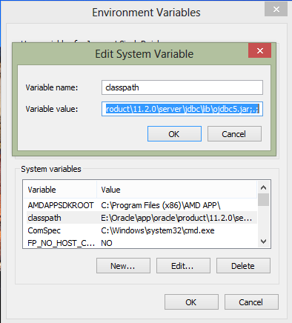
JDBC Examples
To connect java application with the Oracle database ojdbc5.jar file is required to be loaded.
E:\Oracle\app\oracle\product\11.2.0\server\jdbc\lib\ojdbc5.jar

Slide 28
JDBC Examples
import java.sql.*;
class db2
{
public static void main(String args[])
{ try
{
//step1 load the driver class
Class.forName("oracle.jdbc.driver.OracleDriver");
//step2 create the connection object
Connection con=DriverManager.getConnection("jdbc:oracle:thin:@localhost:1521:xe","system","oracle");
//step3 create the statement object
Statement stmt=con.createStatement();
//step4 execute query
ResultSet rs=stmt.executeQuery("select * from student");
System.out.println("Values from student table are:");

Slide 29
JDBC Examples
while(rs.next( ))
System.out.println(rs.getString(1)+" "+rs.getString(2)+" "+rs.getDate(3)+" "+rs.getFloat(4));
//step5 close the connection object
con.close( );
}
catch(Exception e)
{
System.out.println(e);
}
}
}

Slide 30
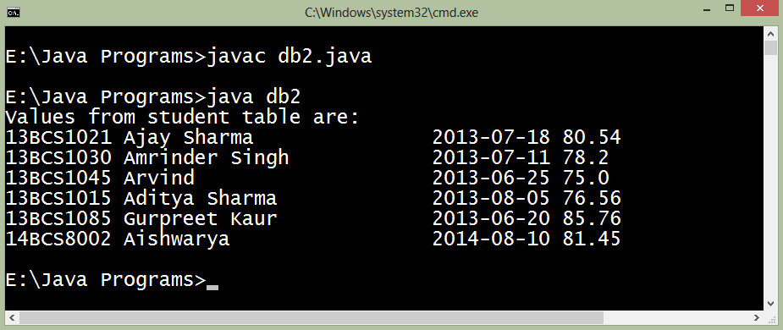
JDBC Examples
OUTPUT

Slide 31
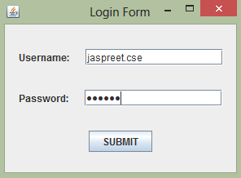
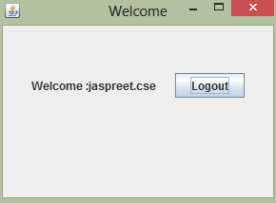
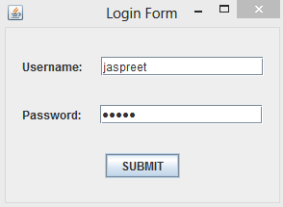
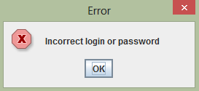
JDBC Examples
Login application using Java Swings and Oracle

Slide 32
JDBC Examples
import javax.swing.*;
import java.sql.*;
import java.awt.*;
import java.awt.event.*;
class logindemo extends JFrame implements ActionListener
{
JButton b1;
JLabel label1,label2;
JTextField text1,text2;
logindemo( )
{ setTitle("Login Form");
setLayout(new FlowLayout(FlowLayout.CENTER,20,30));
label1 = new JLabel("Username:");
add(label1);
text1 = new JTextField(15);
add(text1);
label2 = new JLabel("Password:");
add(label2);
text2 = new JPasswordField(15);
add(text2);
b1=new JButton("SUBMIT");
add(b1);
b1.addActionListener(this);
setVisible(true);
setSize(300,220);
setDefaultCloseOperation(JFrame.EXIT_ON_CLOSE); }

Slide 33
JDBC Examples
public void actionPerformed(ActionEvent ae)
{
String value1=text1.getText();
String value2=text2.getText();
try
{
Class.forName("oracle.jdbc.driver.OracleDriver");
Connection con = DriverManager.getConnection("jdbc:oracle:thin:@localhost:1521:xe","system","oracle");
Statement st=con.createStatement();
ResultSet rs=st.executeQuery("select * from login where username='"+value1+"'and password='"+value2+"'");
String uname=null;
String pass=null;
if(rs.next( ))
{
uname=rs.getString("username");
pass=rs.getString("password");
}

Slide 34
JDBC Examples
if(value1.equals(uname)&&value2.equals(pass))
{
System.out.println("login successfull");
setVisible(false);
NextPage page=new NextPage(value1);
page.setVisible(true); }
else
{
JOptionPane.showMessageDialog(null,"Incorrect login or password","Error",JOptionPane.ERROR_MESSAGE);
text1.setText("");
text2.setText("");
text1.requestFocusInWindow();
}
}
catch(Exception e)
{
System.out.println(e.toString( ) );
} }
public static void main(String arg[])
{
new logindemo( ); }
}

Slide 35
JDBC Examples
class NextPage extends JFrame implements ActionListener
{
NextPage(String st)
{
setLayout(new FlowLayout(FlowLayout.CENTER,20,50));
setTitle("Welcome");
setSize(300,220);
JLabel lab=new JLabel("Welcome :"+st);
add(lab);
JButton b2=new JButton("Logout");
add(b2);
b2.addActionListener(this);
}
public void actionPerformed(ActionEvent e)
{
logindemo demo=new logindemo( );
demo.setVisible(true);
setVisible(false);
setDefaultCloseOperation(JFrame.EXIT_ON_CLOSE);
}
}

Slide 36
JDBC Examples
JDBC - Insert Records
//STEP 4: Execute a query
System.out.println("Inserting records into the table...");
stmt = conn.createStatement();
String sql = "INSERT INTO Student " + "VALUES (100, 'Zara', '10-jul-14', 80)";
stmt.executeUpdate(sql);
System.out.println("Inserted records into the table...");

Slide 37
JDBC Examples
Drop an existing Database::
//STEP 4: Execute a query
System.out.println("Deleting database...");
stmt = conn.createStatement();
String sql = "DROP DATABASE STUDENTS"; stmt.executeUpdate(sql);
System.out.println("Database deleted successfully...");

Slide 38
JDBC Examples
Create a table:
//STEP 4: Execute a query
System.out.println("Creating table in given database...");
stmt = conn.createStatement();
String sql = "CREATE TABLE REGISTRATION " + "(id INTEGER not NULL, " + " first VARCHAR(255), " + " last VARCHAR(255), " + " age INTEGER, " + " PRIMARY KEY ( id ))"; stmt.executeUpdate(sql);
System.out.println("Created table in given database...");

Slide 39
JDBC Examples
JDBC - Drop Tables
//STEP 4: Execute a query
System.out.println("Deleting table in given database...");
stmt = conn.createStatement();
String sql = "DROP TABLE REGISTRATION "; stmt.executeUpdate(sql);
System.out.println("Table deleted in given database...");

Slide 40
Thanks…..

